Slide 1

Pike County ALS/BLS Assessment Findings
June, 2022

Slide 2
Plan Intent & Goal
The Purpose of this review is to assess pre-existing conditions, assess the implemented options for improvement and to help further enhance the emergency medical services available to Pike County Residents and visitors.
The goal is to clarify how EMS response for BLS and ALS has improved since implementation over the years and help identify ways to secure means of funding for long term sustainability for the adequate provision of EMS in Pike County, PA.

Slide 3
Overview
The difference between BLS and ALS is the degree of skills and medications allowed
The skills of bls always comes before als skills
Training is available to help transition bls providers to use als techniques
EMT Scholarship program is available due to donors

Slide 4
2022 Existing services
Unit Name | Station Number | # Transport Capable Units | Paid Staff | Volunteer Staff
Bushkill EMS (dispatched by Monroe) | 3 | 2 | 2 Units | Supplements
Delaware Twp. Ambulance | 28 | 2 | 1 ALS or BLS Unit | Supplements
Dingman Twp Fire | 26 | 3 | 2 Units
Hemlock Farms Fire & Rescue | 29 | 2 | First Unit
Lackawaxen Ambulance | 21 | 3 | First Unit / Second Unit Periodically | Supplements
Lehman Twp. Ambulance | 24 | 3 | ALS & BLS Units
Lake Region EMS | 507 / Lake Region | 3 | 1 ALS or BLS Unit
Milford Fire Dept. | 33 | 1 | 12 Hours a Day | Supplements
Port Jervis Ambulance | 19 | 3 | Covers Westfall / Matamoras
Shohola EMS | 41 | 1 | 12 Hours a Day | Supplements
Tafton Fire and EMS | 37 | 2 | First Unit | Supplements
Westfall Fire Dept. | 39 | 2 | Covered by Port | Full
Newfoundland Ambulance |  | 2 |  | Full

Slide 5

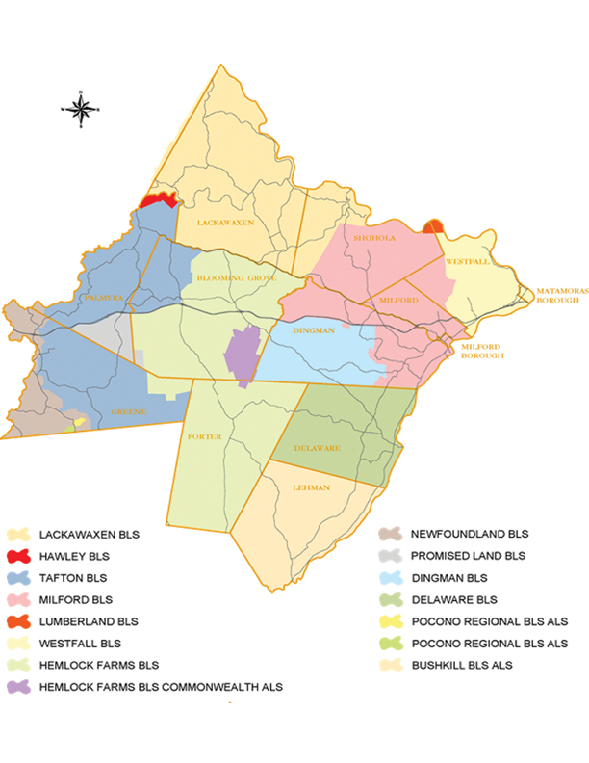
Ems coverage areas 2017

Slide 6
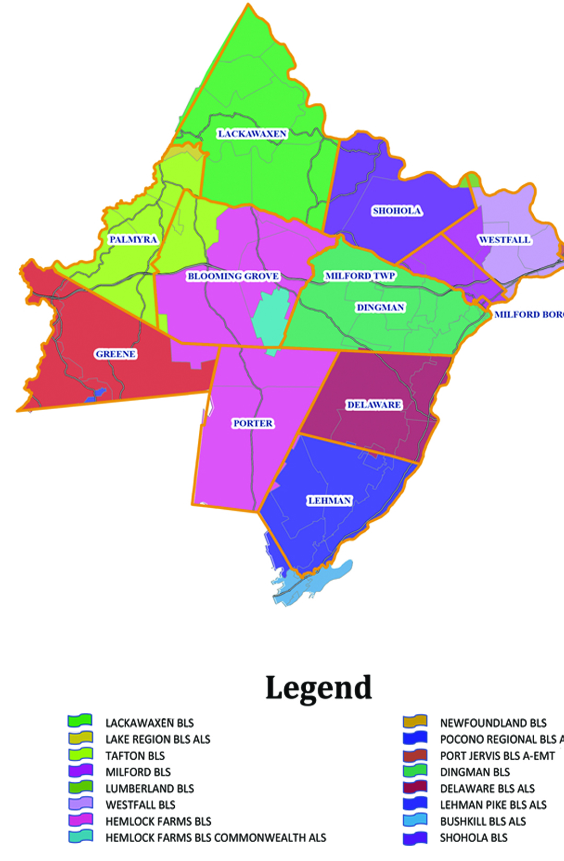
EMS Coverage areas 2022

Slide 7
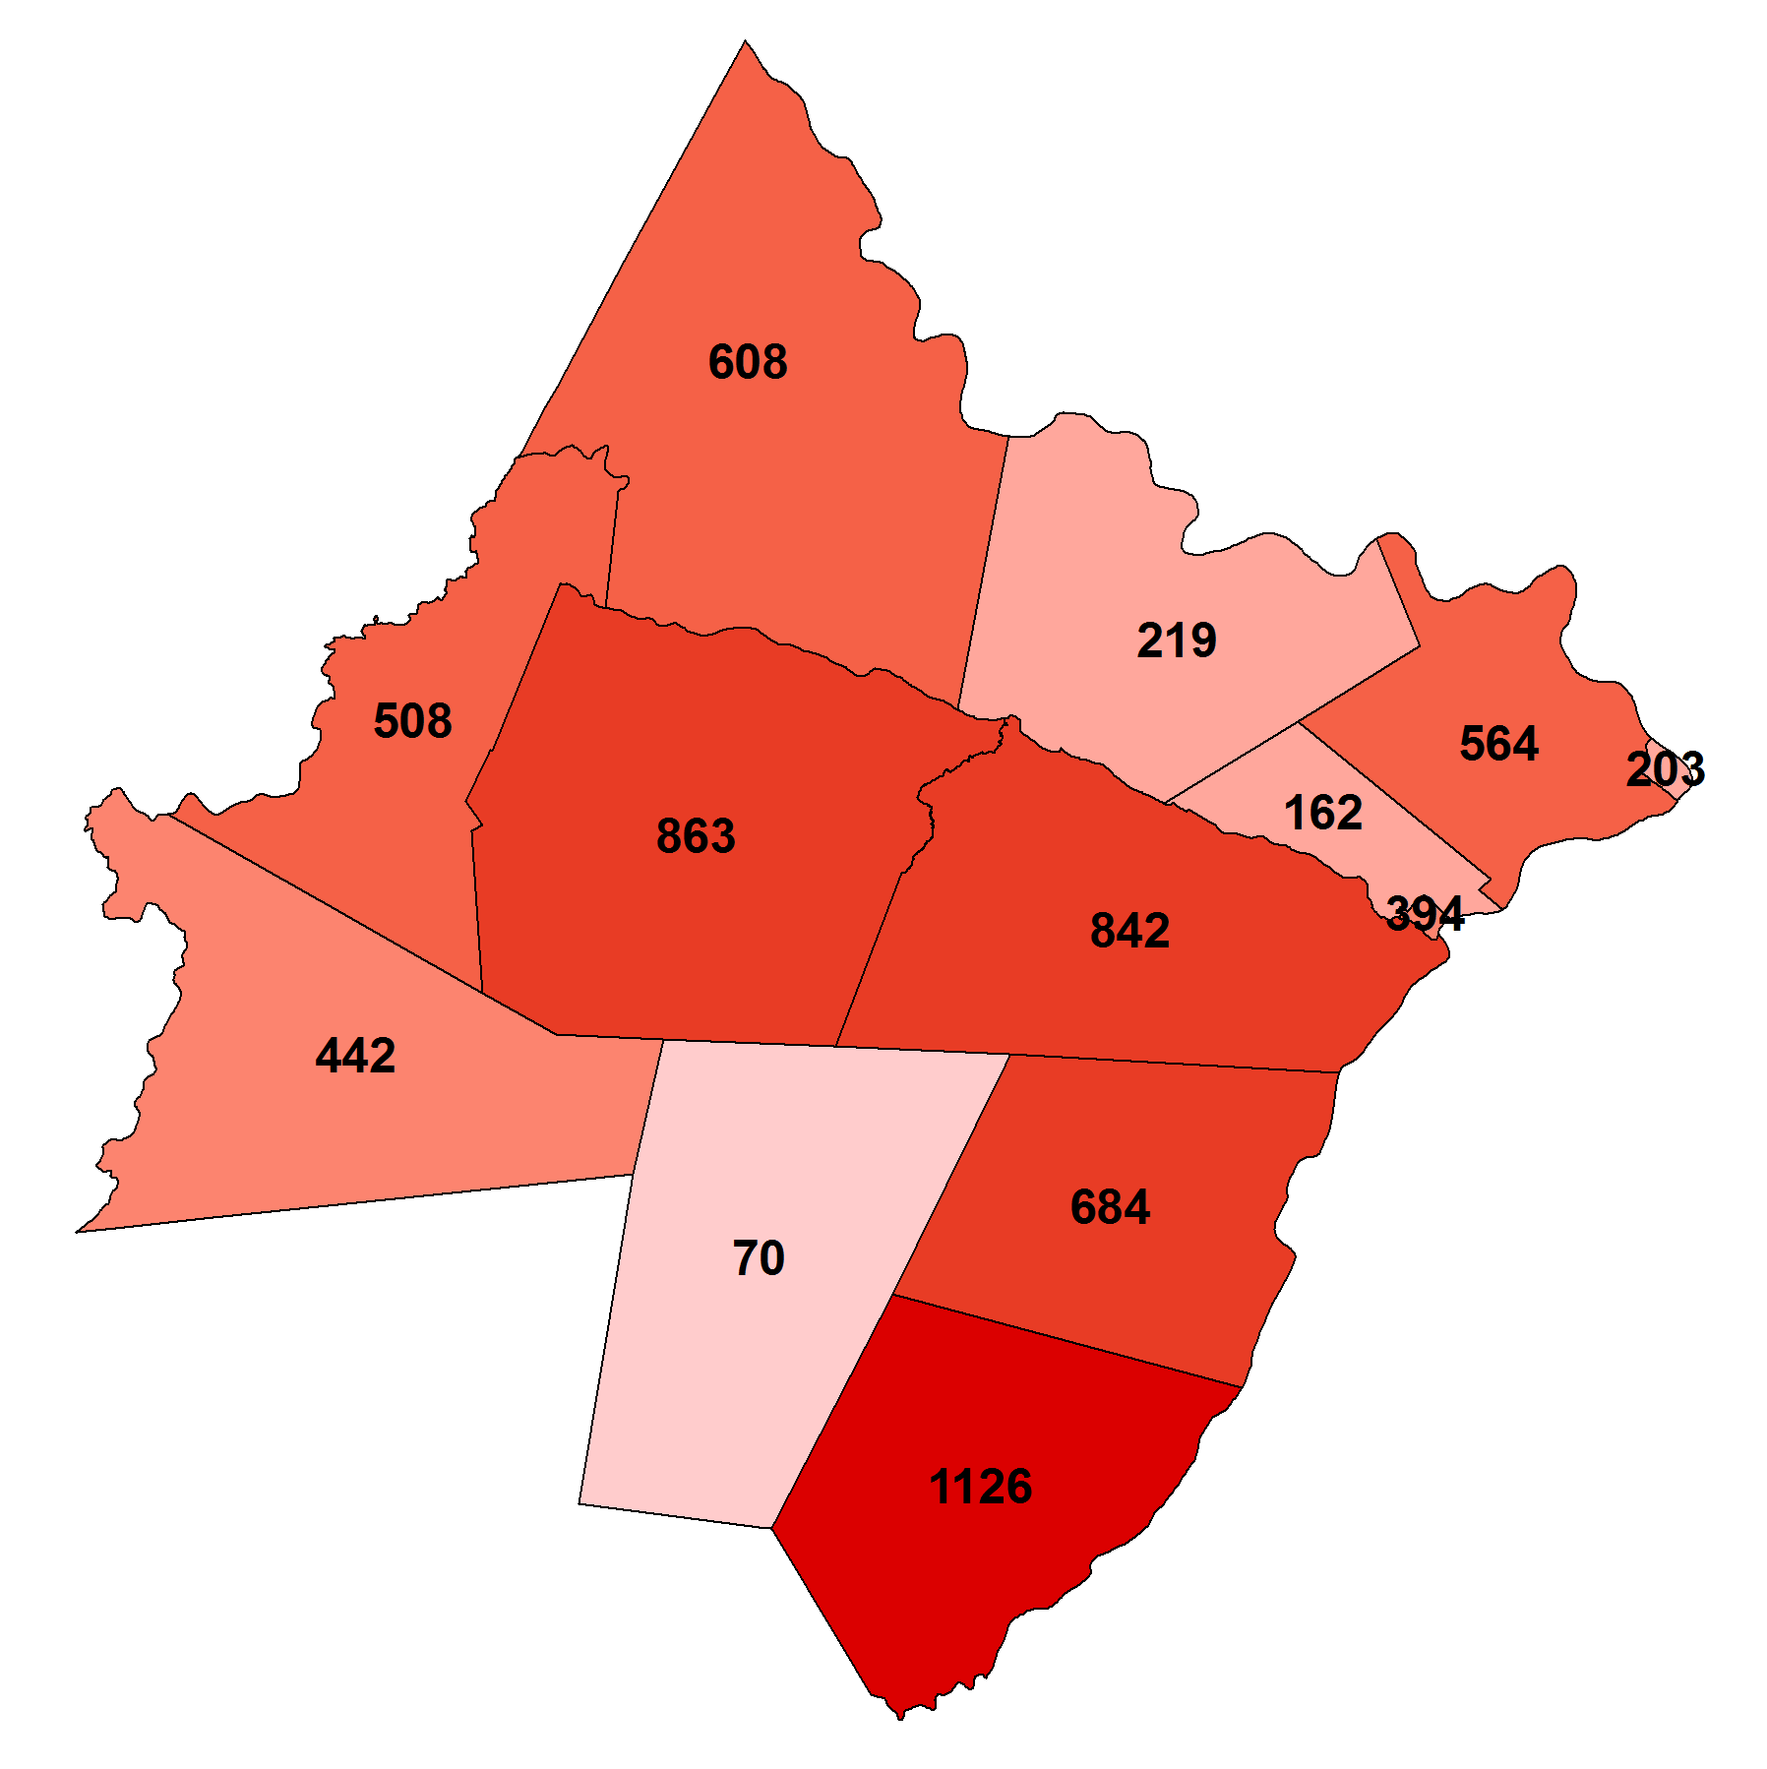
Municipal Completed Calls
623
The map to the right shows the number of calls in 2017 / 2021 within each municipality that were responded to and had patient contact or transport.
6,685 total calls were reported for 2017
6,928 Total Calls were Reported in 2021
262
521
722
332
864
204
916
242
436
62
729
1070

Slide 8
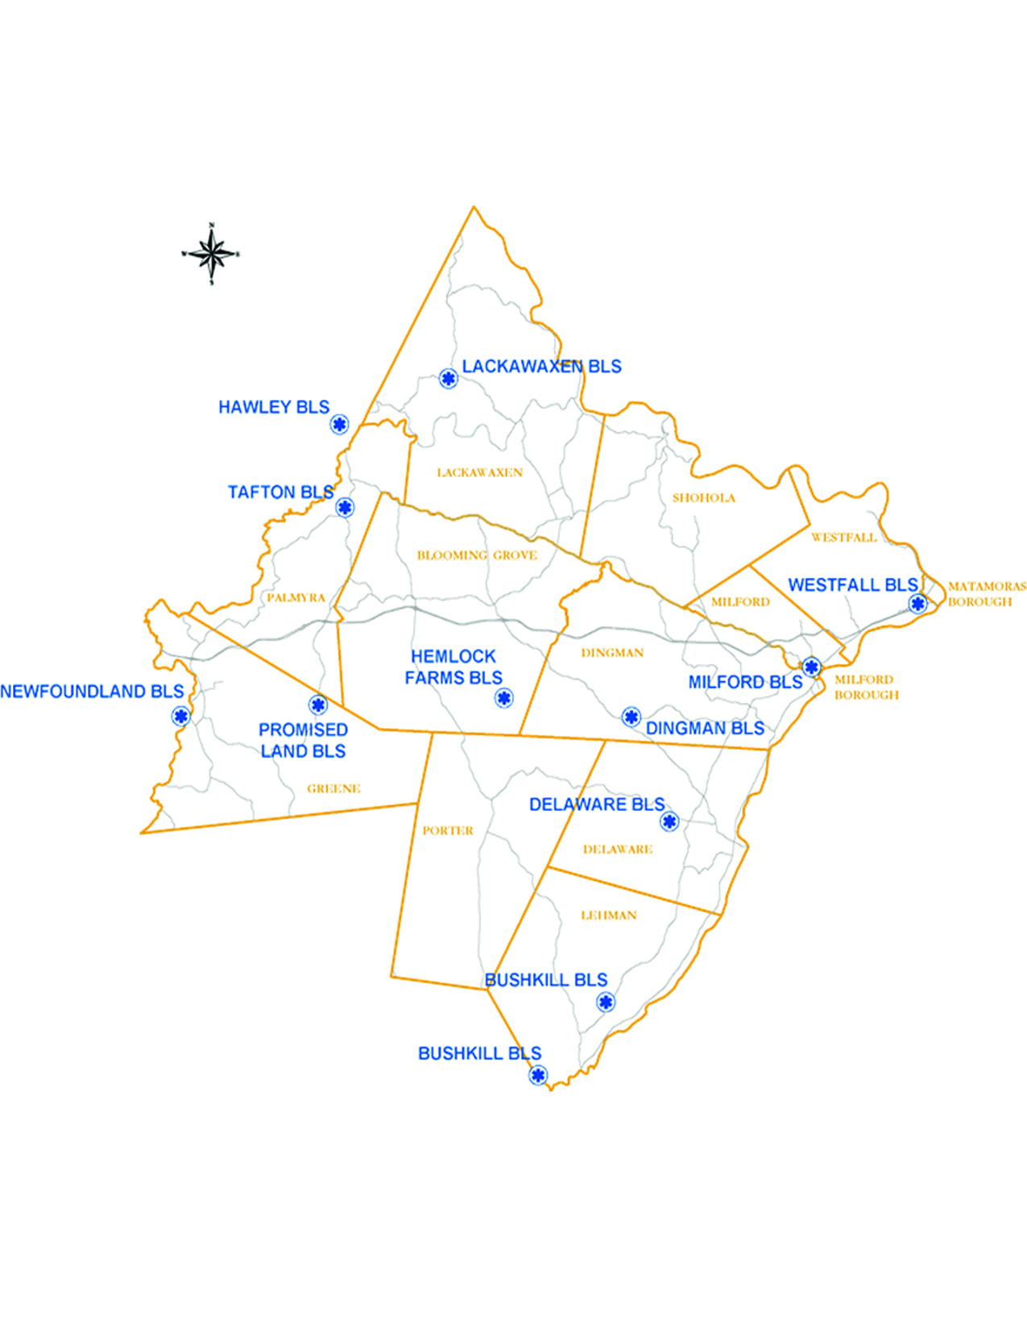
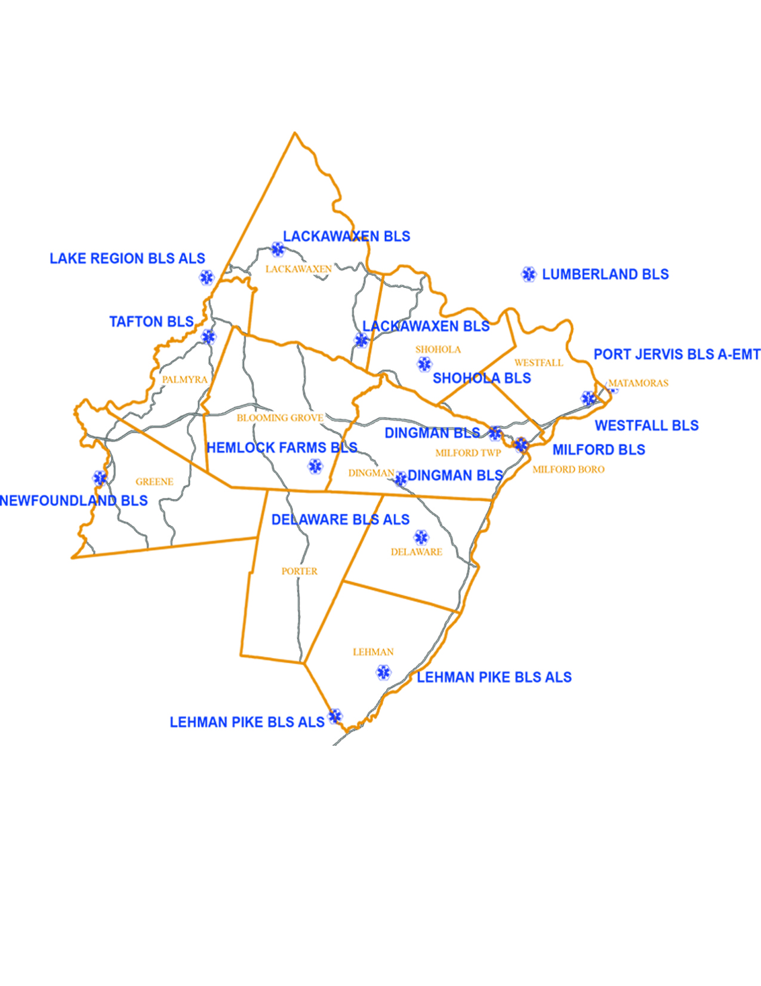
2017 Stations vs. 2022 stations for Ems

Slide 9
Municipal tax status 2018

Slide 10
2022 EMS Tax Status with Voter Referendum
Municipality | Tax Milage
Lackawaxen | 2.5 mil prior to EMS Assessment
Milford Boro | 2 mil after EMS Assessment
Milford Twp. | 2 mil after EMS Assessment
Palmyra Twp. | 2 mil after EMS Assessment
Porter Twp. | 2 mil after EMS Assessment

Slide 11
2022 Designated EMS Tax
Municipality | Tax Millage
Blooming Grove Twp. | .5 mil
Dingman Twp. | .5 mil
Lehman Twp. | .5 mil

Slide 12
Municipality Assisting with EMS Funding
Delaware
Matamoras
Shohola
Westfall

Slide 13
Findings of 2018 assessment
Building bls skills
No initial bls coverage
Reliance of als services to handle bls skilled calls
Bls responding to non-emergent police calls
Coverage time for mutual aid / Out of Service (oos) times
Financial support for emergency services
Emt candidates not finishing the process for emt by 2013 standards

Slide 14
Pike county training center
Run 4 emt classes since study with assistance of donors
Implemented ceu training and courses to assist in skill development and retention

Slide 15
Increased Services
Lehman Pike ems 24 hr. paid bls & als
  193 Municipal dr. bushkill pa
Shohola twp. fire & rescue paid 12 hrs. bls 6 am through 6 pm
  137 maple dr. Shohola pa
Lackawaxen ems paid 80 hr. week bls at Greeley station
  109 rt 590 Greeley pa
Milford fire dept. ems paid 12 hr. bls 6 am through 6 pm
  107 w. Catherine st. milford pa
Dingman twp. fire dept. ems (2) 24 hr. paid bls out of 2 stations
  680 log tavern rd. milford pa and 10 buist rd. milford pa

Slide 16
Out of county ems services
Lake region ems 24 hr. paid bls & als
  15 gravity rd. Hawley pa
Port Jervis ambulance corp. 24 hrs. bls & advanced – emt
  29 church st. port Jervis ny

Slide 17
Potential Recommendations
LEAVE EXISTING AMBULANCE IN PLACE BUT PAY STAFF
PROS | Ten existing Ambulances would remain in same geographical area; fire dept. ambulances would still be able to bill insurance companies for services; reduction in “burn out” from volunteers trying to cover both fire and medical calls
CONS | Would need financial and organizational support from ALL municipalities and ambulance corps
LONG/SHORT TERM | Short
Plan in Use | $$ | County is matching up to 2 mils of tax funding per municipality
RESPONSIBLE PARTY | All Municipalities

Slide 18
IMPROVED TRAINING FOR EXISTING BLS PROVIDERS
PROS | More skilled EMTs; Less demand put on ALS; Greater utilization of County Training Center; Flexibility to schedule trainings as needed
CONS | Trained personnel leave for paid career positions
LONG/SHORT TERM | Short
COST | $ | Emergency Medical Technician Initial Training - $1,600 200 HOURS Scholarship funded through the Greater Pike EMS Fund
RESPONSIBLE PARTY | Pike County Training Center

Slide 19
CHANGE LEGISLATION THAT LIMITS EMS TAX
PROS | Municipalities could adequately support EMS services via taxation
CONS | Legislation may be changed undesirably
LONG/SHORT TERM | Long
COST | N/A | House Bill 2601 addresses this going from .05 mil to 1.5 mil
RESPONSIBLE PARTY | State Legislators

Slide 20
MUNICIPAL LEVY OF EMS TAX
PROS | Dedicated annual funding to secure quality emergency medical services; May assist with paid staff rather than relying on volunteers
CONS | Millage rate limitations (as called out in Township/Borough Code); May not be well received by residents
LONG/SHORT TERM | Short
COST | ----- | Milford, Milford Twp., & Porter Twp. have adopted this since the last report
RESPONSIBLE PARTY | Municipality

Slide 21
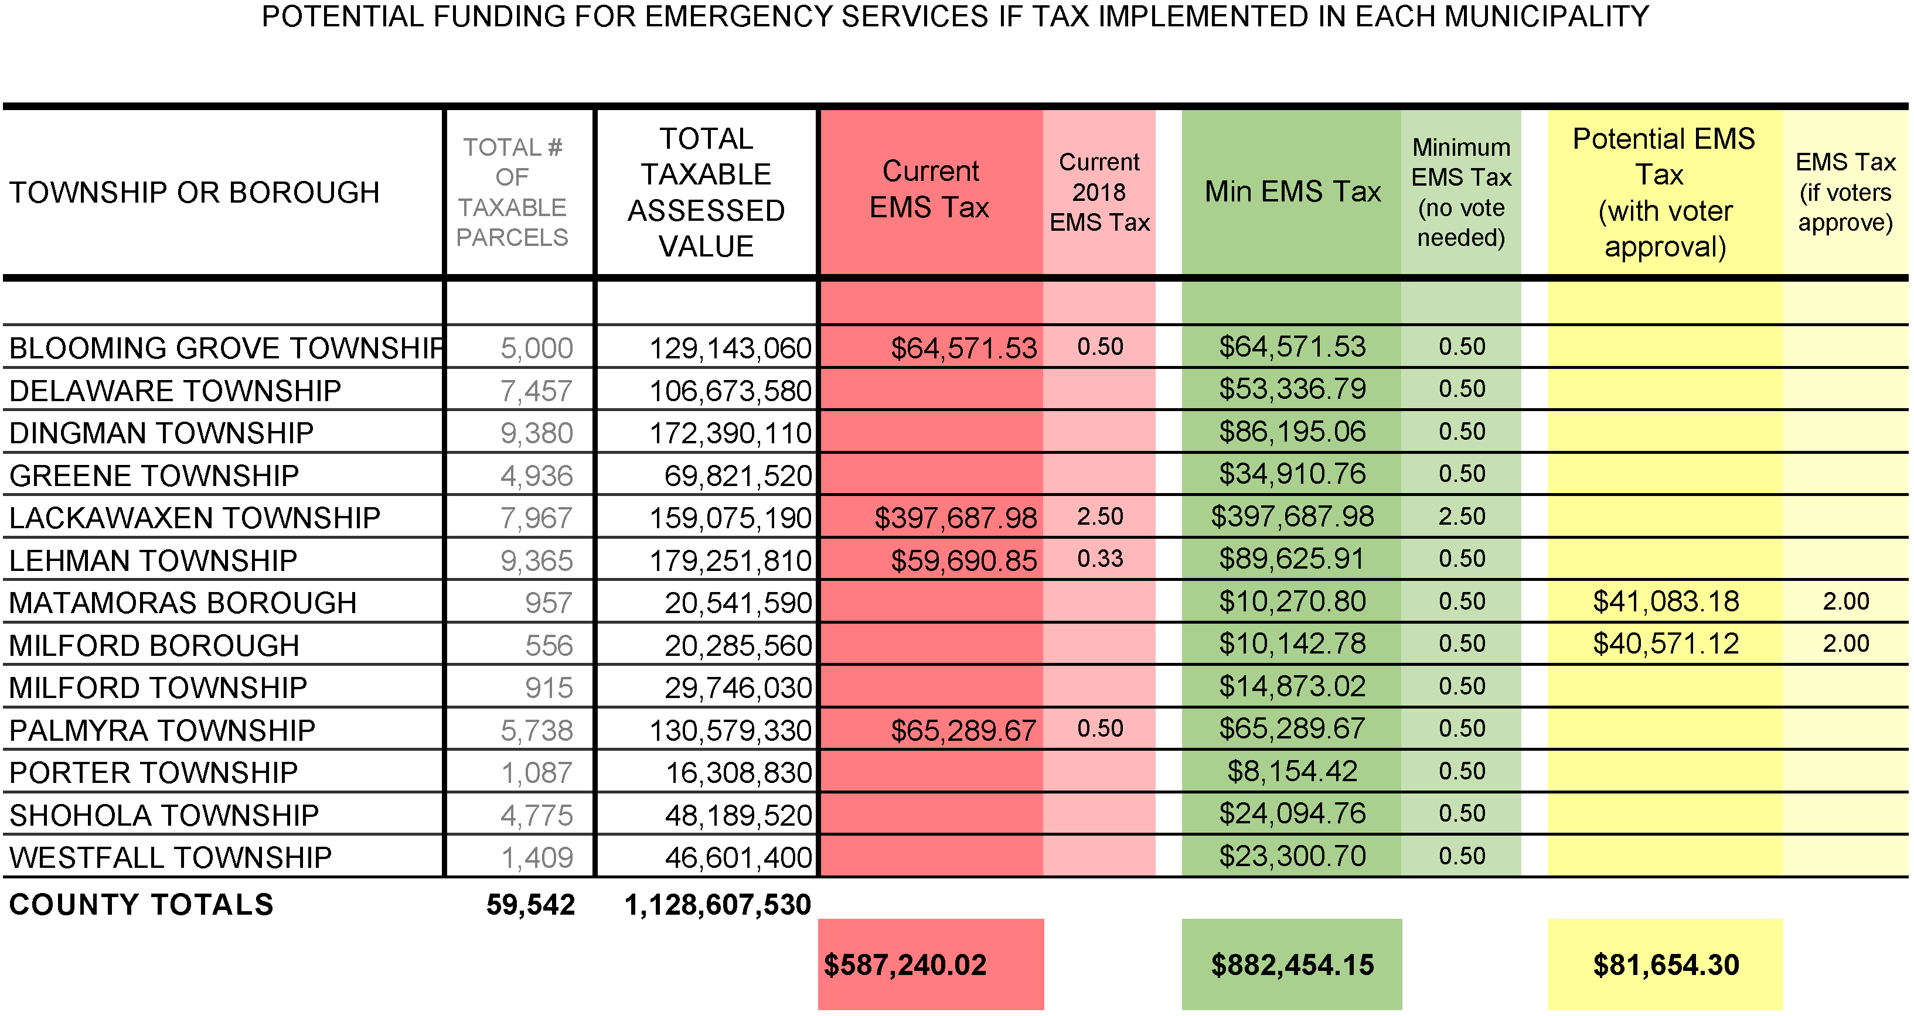

Slide 22
Average Response time in 2017 vs. 2022
Municipality | First Due {Unit#) | Other First Due {Unit#) | Cover Unit | 2022 Response Time Dispatch to on Scene
Blooming Grove Twp | 7.7 {29} | 12.6 {37} | 20.9 {29} 15.3 {37} | 7 mins with Response in 2.2 mins
Delaware Township | 12.9 {28} |  | 22 | 8.4 mins with Response in 1.3 mins
Dingman Township | 18.9 {26} | 19.5 {33} | 25.3 {26} 18.9 {33} | 11.8 mins with Response in 2.2 mins
Greene Township | 19.8 {37} |  | 36.9 | 20.2 mins with Response in 3.9 mins (37)
Lackawaxen Township | 14.3 {21} |  | 28.7 | 13.9 mins with Response in 3.4 mins
Lehman Twp. |  |  |  | 11.2 mins with Response in 2.7 mins
Matamoras Borough | 10 {39} |  | 10 | 10.2 mins with Response in 2.8 mins (19)
Milford Borough | 10.6 {33) |  | 20 | 7.4 mins with Response in 3.2 mins
Milford Township | 16.2 {33} |  | 19.2 | 12.4 mins with Response in 2.2 mins
Palmyra Township | 10.4 {37} |  | 37 | 10.2 mins with Response in 3 mins
Porter Township | 12.2 {29} |  | 21 | 11.8 mins with Response in 2.4 mins
Shohola Township | 27 {33} | 33.3 {21} | 29.8 {33} 36.6 {21} | 8.25 mins with Response in 2 mins (41) 19 mins with Response in 3 mins (26) 11.5 mins with Response in 3.5 mins (21)
Westfall Township | 11.6 {39} |  | 16.3 | 9.6 mins with Response in 3 mins (19) 11.8 mins with Response in 5.6 mins (39)
Above is the average response time in minutes from dispatch to on-scene

